Slide 1
Credit Card Analytics Report

Slide 2
Objective
To develop a comprehensive credit card weekly dashboard that provide real-time insights into key performance metrics and trends, enabling stakeholders to monitor and analyze credit card operations effectively.

Slide 3
Import Data to SQL database
Prepare csv file
Create tables in SQL
Import csv file into SQL

Slide 4
DAX Queries
AgeGroup = SWITCH(
TRUE(),
'public cust_detail'[customer_age] < 30, "20-30",
'public cust_detail'[customer_age] >= 30 && 'public cust_detail'[customer_age] < 40, "30-40",
'public cust_detail'[customer_age] >= 40 && 'public cust_detail'[customer_age] < 50, "40-50",
'public cust_detail'[customer_age] >= 50 && 'public cust_detail'[customer_age] < 60, "50-60",
'public cust_detail'[customer_age] >= 60, "60+",
"unknown"
)

Slide 5
DAX Queries
IncomeGroup = SWITCH(
TRUE(),
'public cust_detail'[income] < 35000, "Low",
'public cust_detail'[income] >= 35000 &&
'public cust_detail'[income] = 70000, "High",
"unknown"
)

Slide 6
DAX Queries
week_num2 = WEEKNUM('public cc_detail'[week_start_date])
Revenue = 'public cc_detail'[annual_fees] + 'public cc_detail'[total_trans_amt] + 'public cc_detail'[interest_earned]
Current_week_Reveneue = CALCULATE(SUM('public cc_detail'[Revenue]), FILTER( ALL('public cc_detail'), 'public cc_detail'[week_num2] = MAX('public cc_detail'[week_num2])))
Previous_week_Reveneue = CALCULATE( SUM('public cc_detail'[Revenue]), FILTER( ALL('public cc_detail'), 'public cc_detail'[week_num2] = MAX('public cc_detail'[week_num2])-1))

Slide 7
Insights
Revenue – 55.3 M
Total Transaction – 45M
Total Interest - 7.8M
Transaction Vol – 655.7K
Income – 575.9M
Average Customer Satisfaction Score 3.19/5

Slide 8
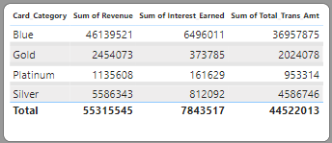
Card Category Vs Revenue
Blue Card has the highest revenue

Slide 9
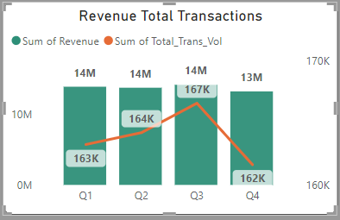
Quarter Vs Revenue Vs Transaction
Quarter 3 has the highest transaction volume which leads to highest revenue

Slide 10
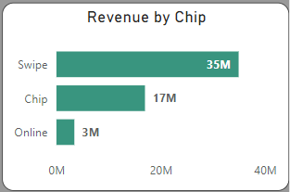
Most used Transaction Method
Swipe Is the most used Transaction Method

Slide 11
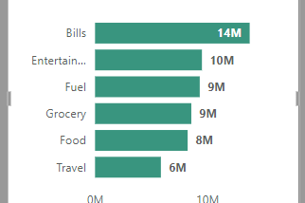
Revenue By Expenditure Type
Most customers has used their credit cards to pay bill

Slide 12
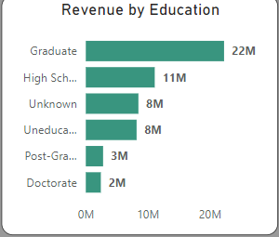
Revenue Vs Education
Most of the Customers are Graduate

Slide 13
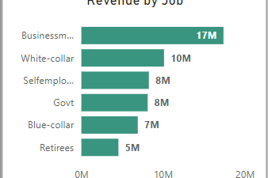
Revenue By Job Role
Customers who are businessman generates the highest revenue

Slide 14
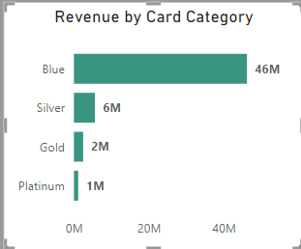
Revenue By Card Category
Blue Card is the most popular Card category and generates the highest revenue of 46M

Slide 15
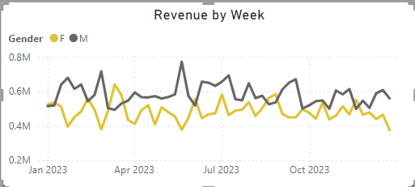
Revenue By Week

Slide 16
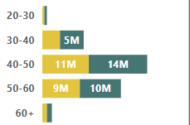
Revenue By Age Group
Cutomers of Age Group 40-50 generates the highest revenue 25M out of which 11M are Females and 14M are males

Slide 17
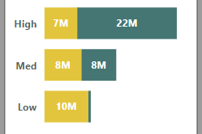
Revenue By Income Group
High Income Group Customers generates the highest revenue 29M out of which 7M are Females and 22M Male.

Slide 18
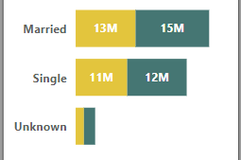
Revenue Vs Maritial Status
Married Customers generates the highest Revenue out of Which 13M are Females and 15M Male.

Slide 19
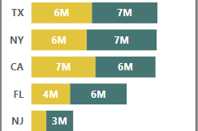
Revenue By State
Texas Generates the Highest Revenue

Slide 20
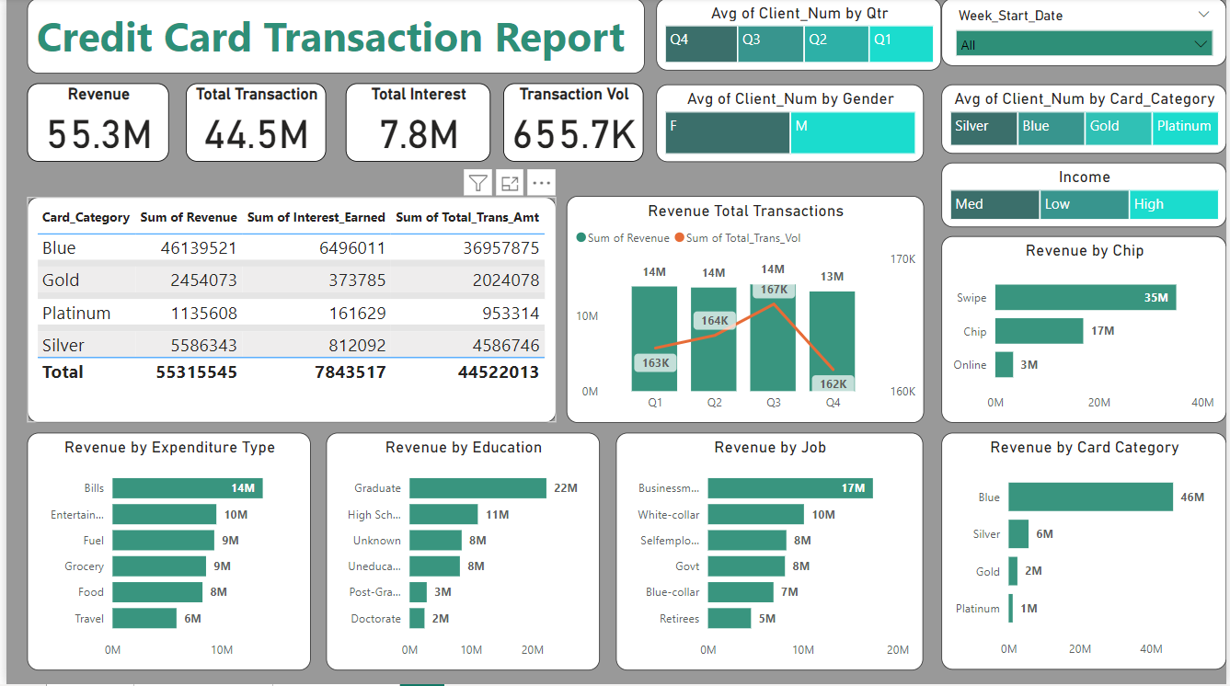

Slide 21
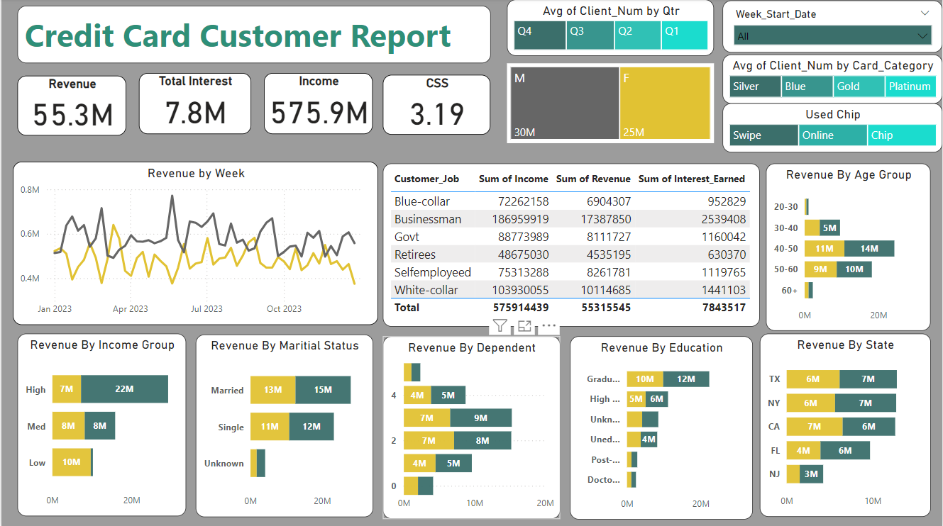

Slide 22
Thank You

